Slide 1
COVID 19 Data Analysis Project
PTDA16
Masai Group 2A –
Abhishek Pandey
Swapnil Pandey
Himanshu Khandelwal
Harsh Gour

Slide 2
Content
Introduction
Challenges
KPI’s and Dashboard
Insights
Learnings

Slide 3

COVID19
Coronavirus disease (COVID-19) is an infectious disease caused by the SARS-CoV-2 virus. It affected people and their lives around the globe. There is no specific medication developed till date.
It is very important for researchers, pharmaceutics and administration to analyze the pattern and behavior of the disease so that the damage from it can be minimized.

Slide 4
CHALLENGES
Arrange and set a particular time for meet as some of us are working professionals and some are studying.
The other issue was to make the data-frame out of nested dictionary from JSON data.
Join all the data-frames which had such vivid structures.
Another issue was to share the data files according to the structure of the data.
Joining every data-frames to make a database.
★No Challenge was so big that we cannot overcome it by Team Efforts

Slide 5
Analysis Strategy
Got Covid 19 India data (JSON) from covid19india.org
Made structured data-frame out of the data in python
Imported the data(csv) into SQL and analysed it to insights from it
Made a visualized dashboard on Excel using the output data from SQL

Slide 6
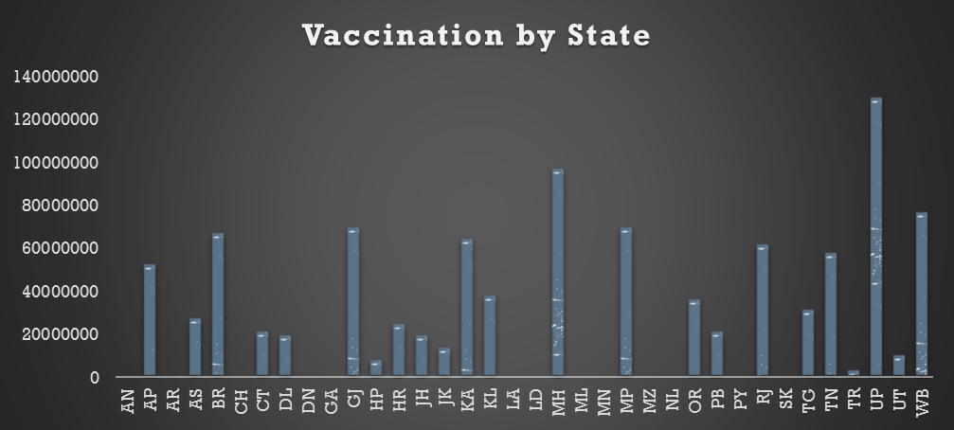
KPI

Slide 7
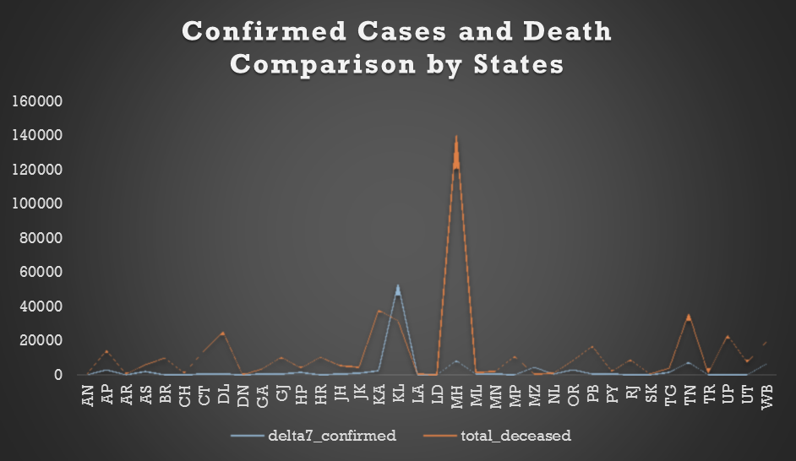
KPI

Slide 8
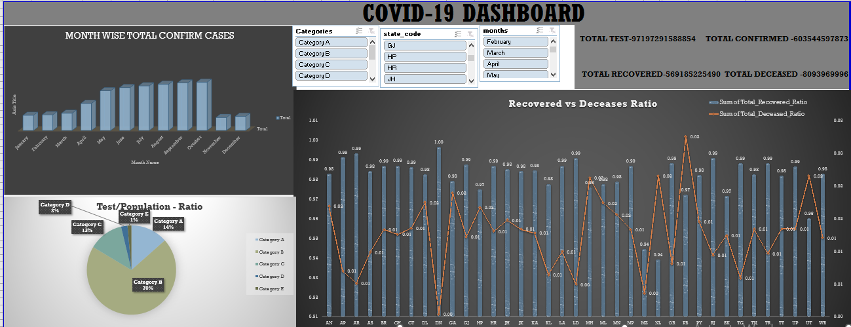

Slide 9
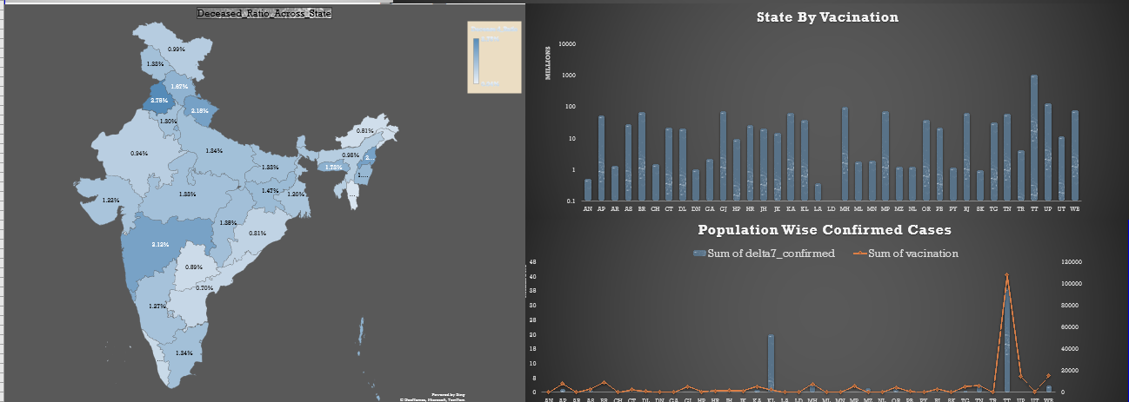

Slide 10
INSIGHTS
The number of deaths were inversely proportional to number of tests done
Covid-19 was more volatile and dreadful in Metropolitan Cities as compared to tier II/ III cities.
The Deceased Ratio is maximum in Punjab & Maharashtra and minimum in Dadra & Nagar Haveli and Mizoram.
The states with more vaccination stats have more recovered cases and comparatively less deceased cases.
States which are vaccinated and less has population density have less confirmed cases also death rate is minimum.

Slide 11
LEARNINGS OF THE TEAM
To Communicate ideas in a way which are understood and mutually altered by the each other
How to divide multiple tasks amongst each other and have them done with the help of each other
How Team Work helps in solving problems which look difficult at the beginning
Learnt to push our learning limits and for that the web is the biggest boon.
The one who try never fails.

Slide 12
THANK YOU
We are Open to answer your Questions

